Slide 1
The exploratory analysis of the effect of environmental factors on transmission of COVID-19
By: Zhaofeng Liu, Uhuru Kamau, Yifan Zhao, Shuyang Lu, Chenhao Zhao
11/16/2021

Slide 2
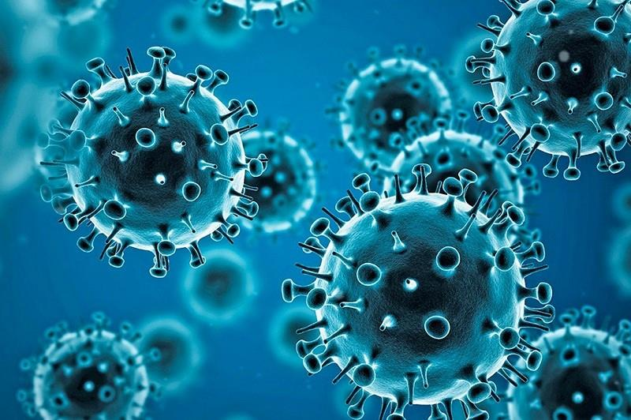
Introduction
1
COVID Impact
The worldwide COVID case total is 251,788,329 (11/12/2021), with more than 5 million deaths and more than 6 million recoveries
COVID
2
AIM I: Weather Condition (Temperature and Humidity ) ~ COVID
Temperature: There is a dose-response relationship suggesting a significantly negative relationship between temperature. The relationship was linear in the range from 16.8 °C to 25.8 °C and then became flat above 25.8 °C
Humidity: In some hotter countries, a 1% increase in humidity reduced number of daily new cases of covid by 0.85%
3
AIM II: Vitamin D ~ COVID
Disease severity and mortality rates due to COVID-19 infection are greater in the elderly and chronically ill patients, populations at high risk for vitamin D deficiency. Vitamin D plays an important role in immune function and inflammation
As very few nutrients naturally contain vitamin D, dietary intake of vitamin D is generally insufficient, Thus sunlight plays a great part in obtaining vitamin D, which can be equally measured by ultraviolet.
Source: WHO COVID dashboard

Slide 3

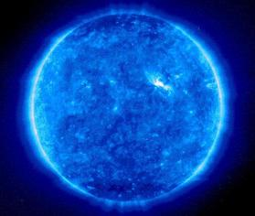
Main Aims
Environmental Factors ~ COVID Cases
01
02
Weather Condition ~ COVID
the correlation relationship between Temperature, humidity and incident rate of covid-19
Vitamin D ~ COVID
the impact of Ultraviolet(Vitamin D) in conjunction with Aim I

Slide 4
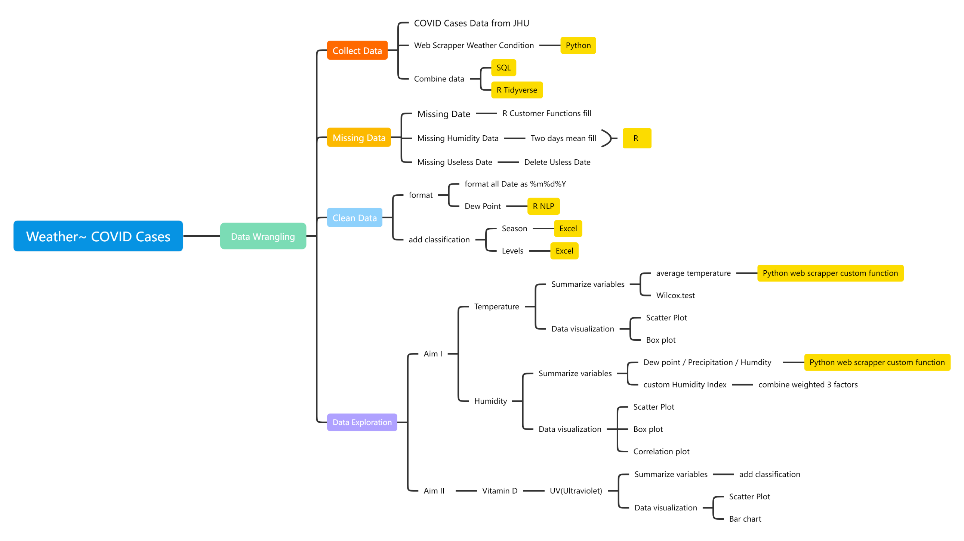
Data Wrangling Pipeline (1)

Slide 5
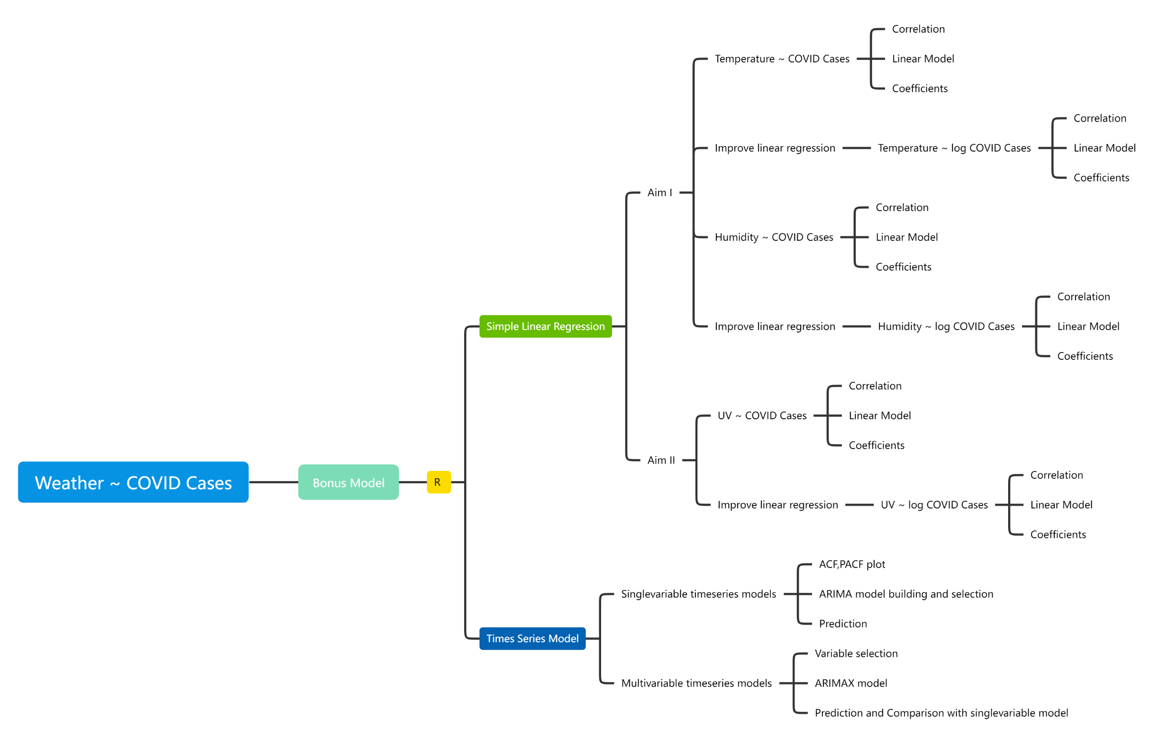
Data Wrangling Pipeline (2)

Slide 6
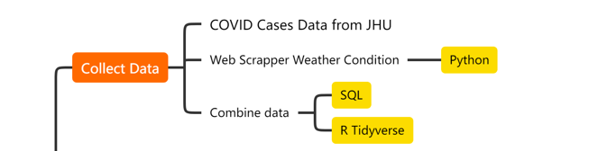
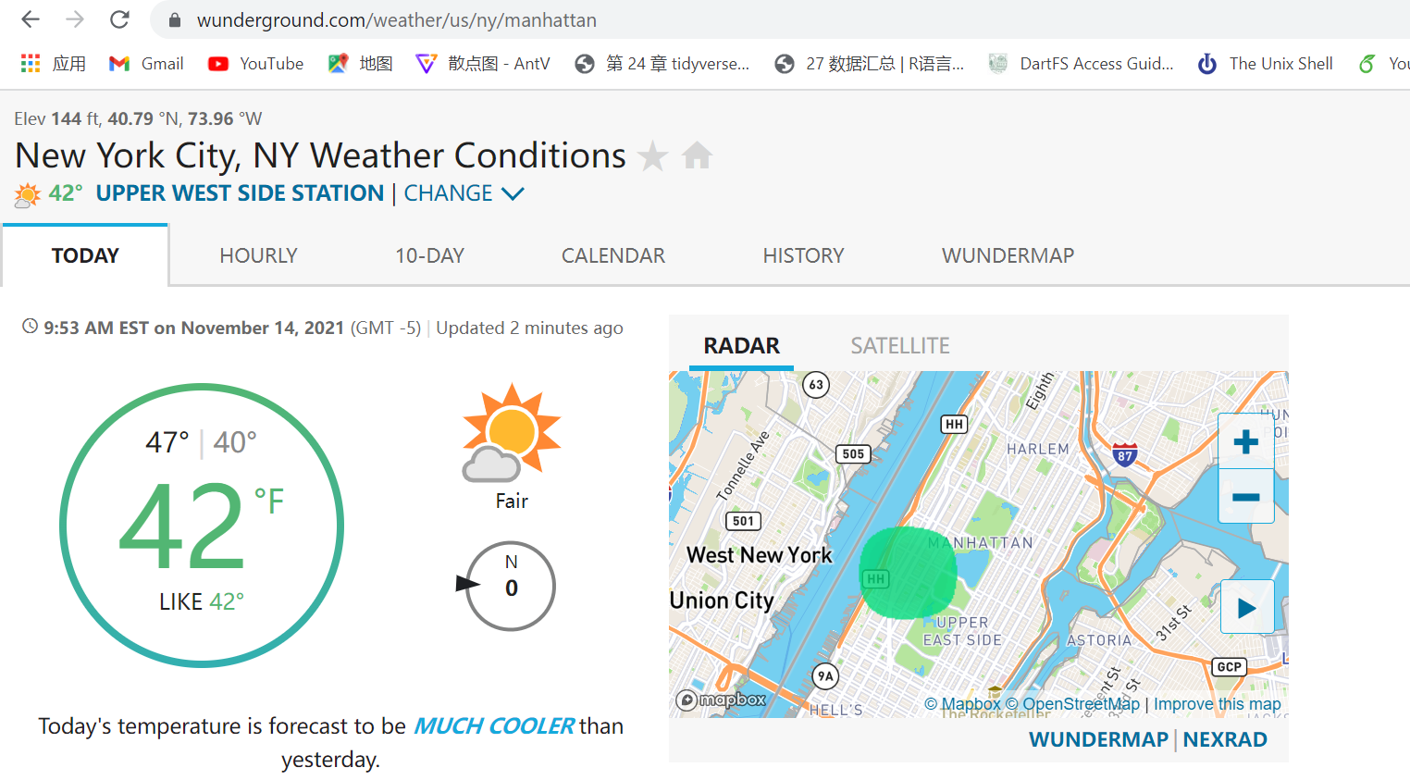
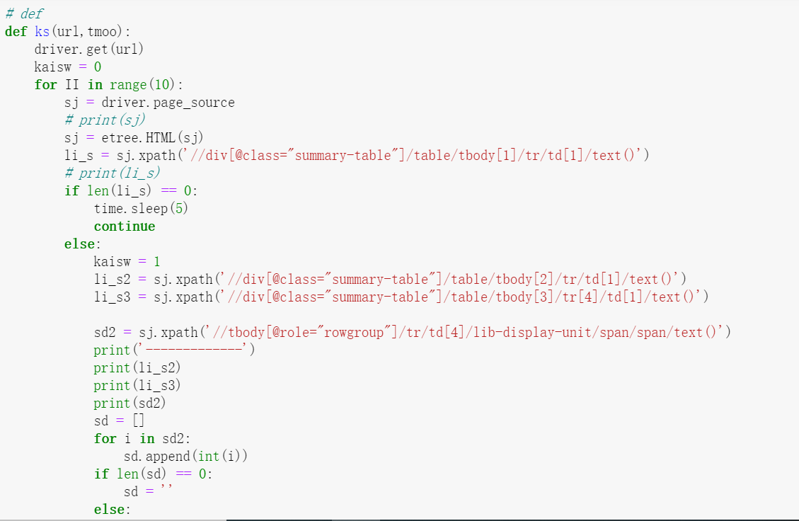
Collect Data
We obtain Covid data frame from JHU
Weather data from Website (https://www.wunderground.com/weather/us/ny/Manhattan)
UV(Ultraviolet) data from website(http://www.cnyweather.com/wxuvdetail.php?r=wxuvdetail.php)
Raw data

Slide 7
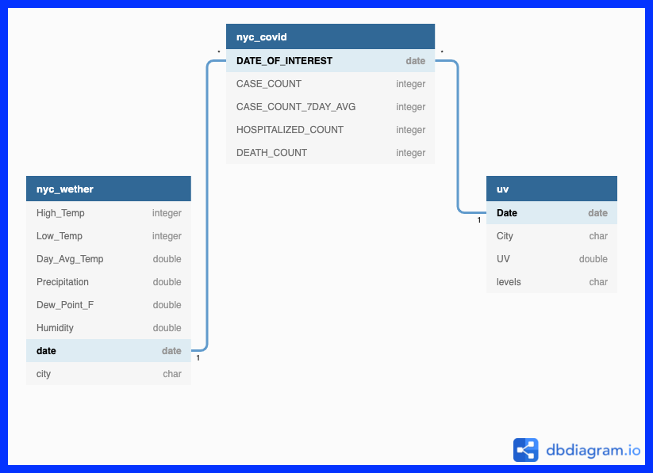
Raw Data - Relation
1
Date:
3/1/2020-10/31/2021

Slide 8
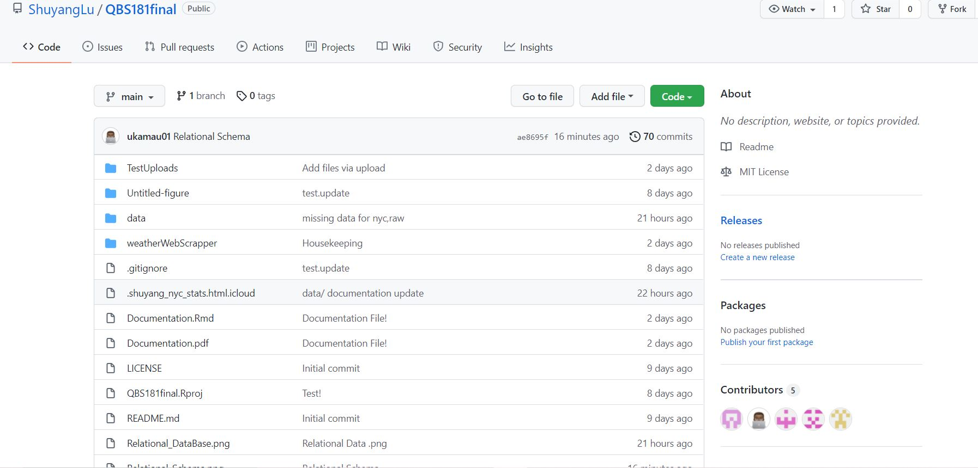
Collaboration - GitHub
GitHub: version control and sharing file/storage
1

Slide 9
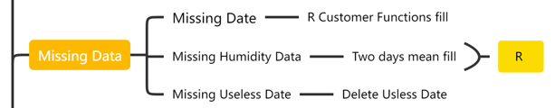
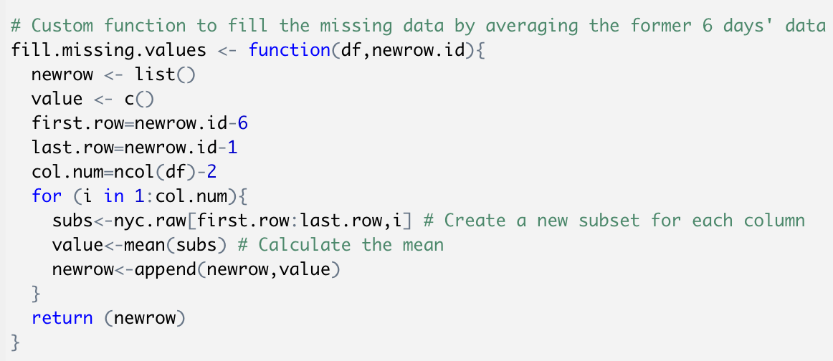
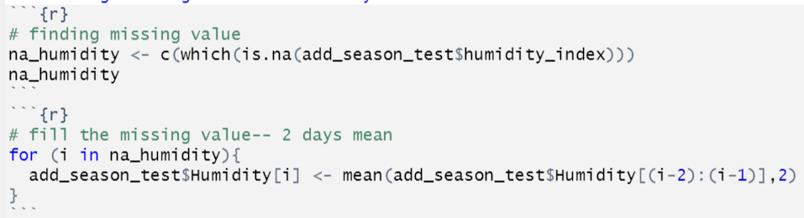
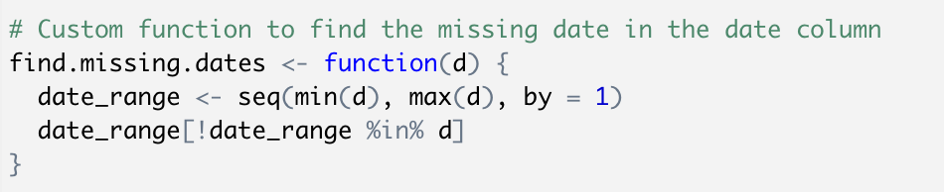
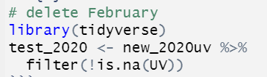
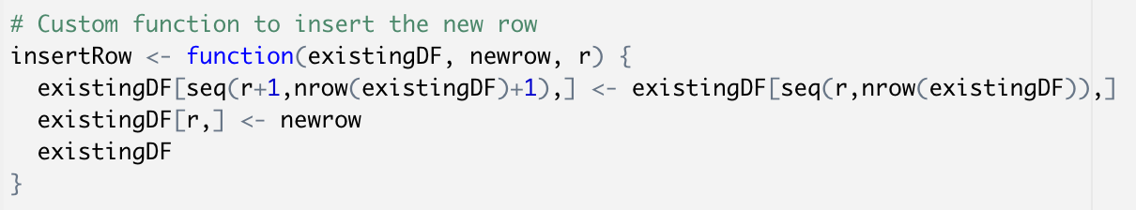
Missing Data
Whole Row Missing Date
Missing Humidity Data
Find the missing dates in the date column
Two days mean fill
Fill the missing data by averaging the former 6 days' data
Missing Useless Date
Filter to delete Feb 30th
Insert the new row into the original dataframe

Slide 10
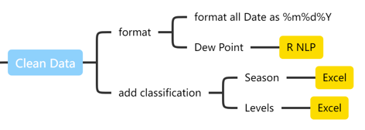
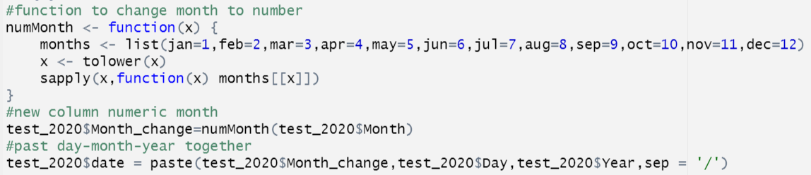
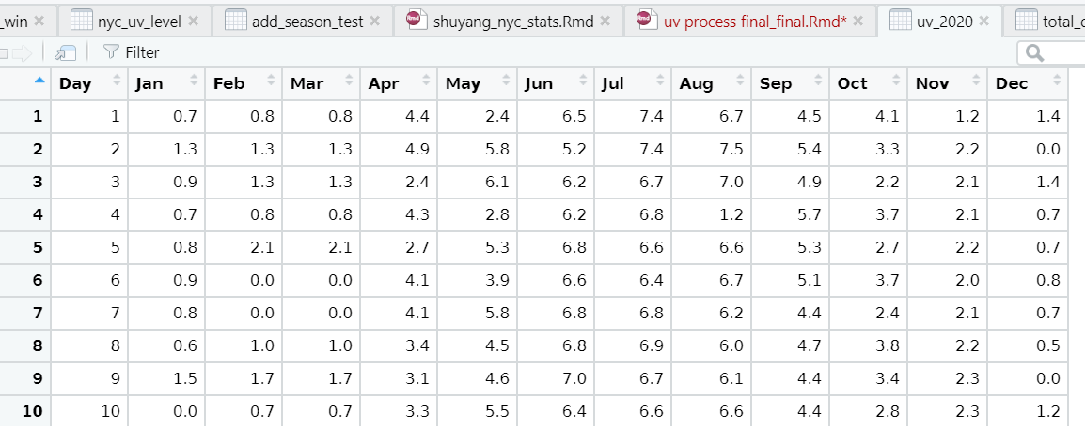
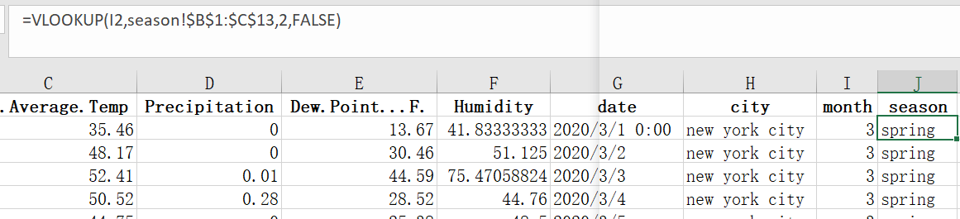
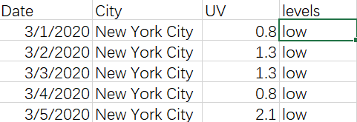
Cleaning Data
Format Date
Format Dew Point Punctuation
2
Add Season (Excel)
Add UV Levels (Excel)

Slide 11

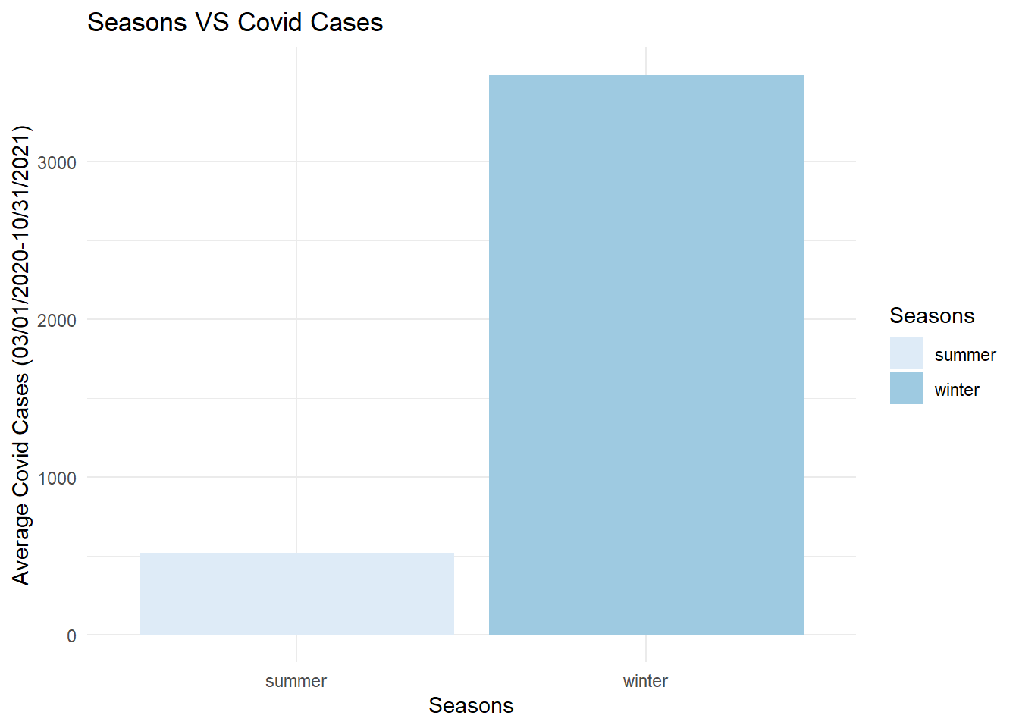
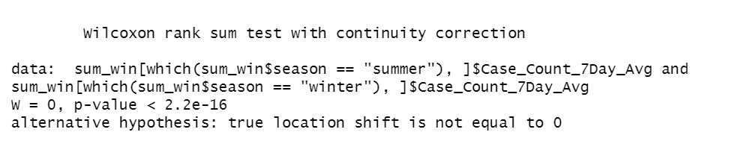
Data Exploration- Aim I(Temperature)
Summer Winter ~ COVID Bar Chart and Wilcox.test
Summer & Winter ~ COVID Cases Bar Chart
Wilcox.test

Slide 12
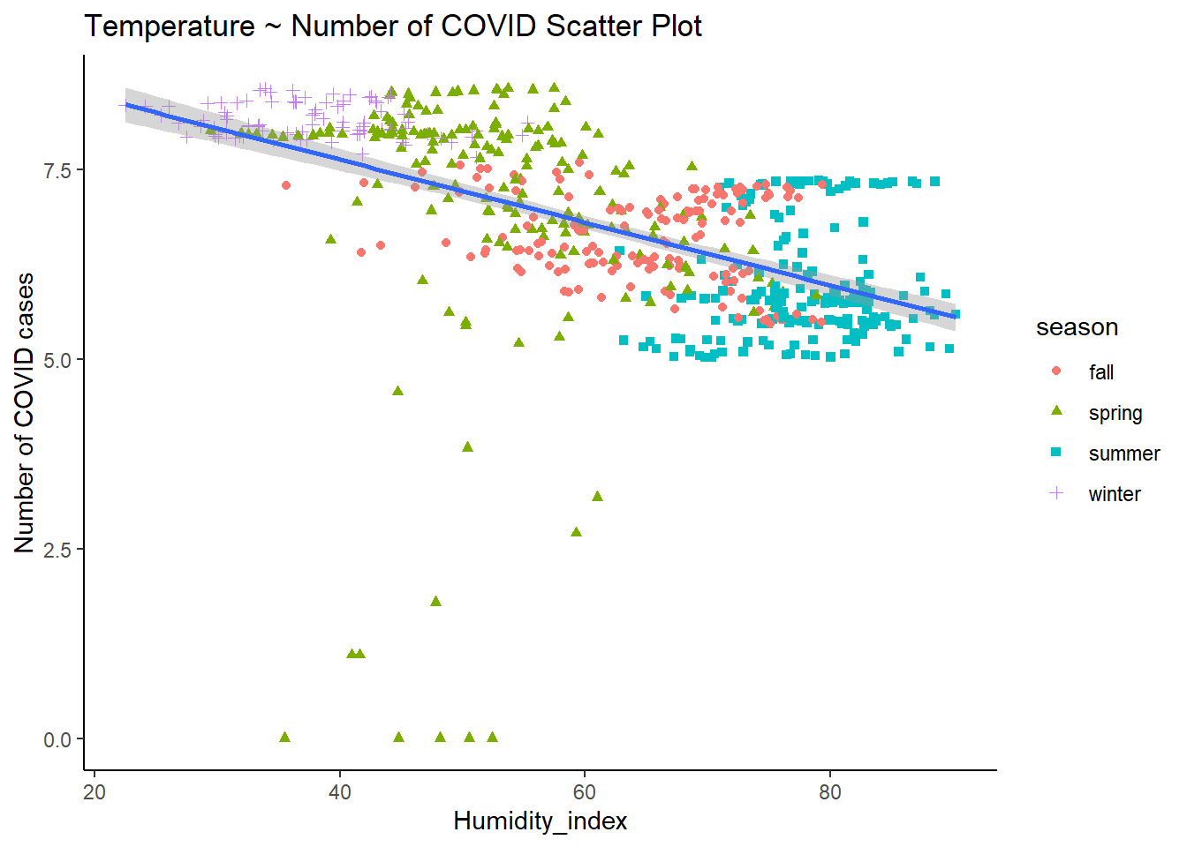
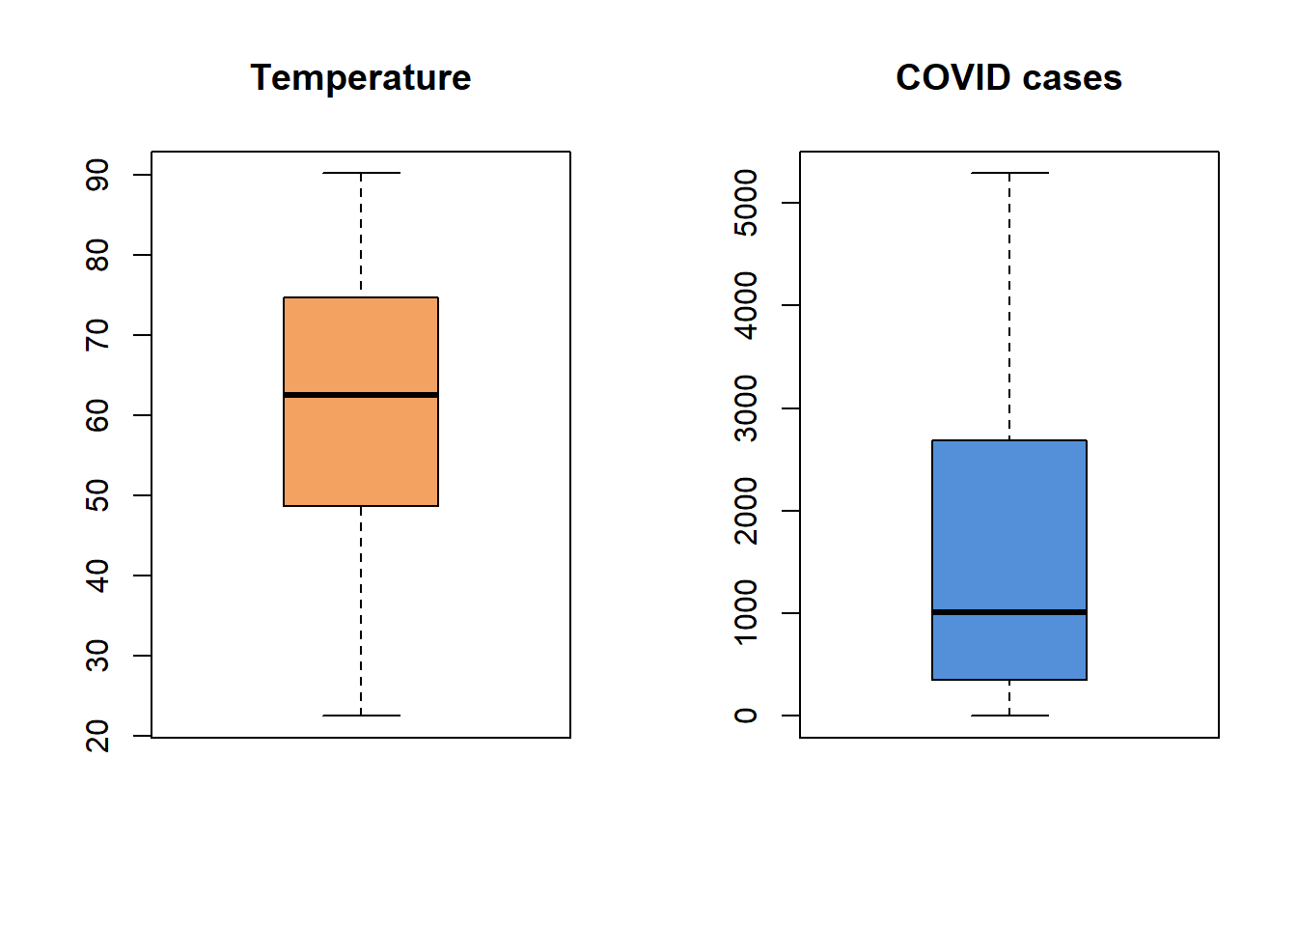
Data Exploration- Aim I(Temperature)
Temperature ~ COVID Cases visualization
Temperature ~ COVID Cases Scatter Plot
Temperature ~ COVID Cases Box Plot

Slide 13
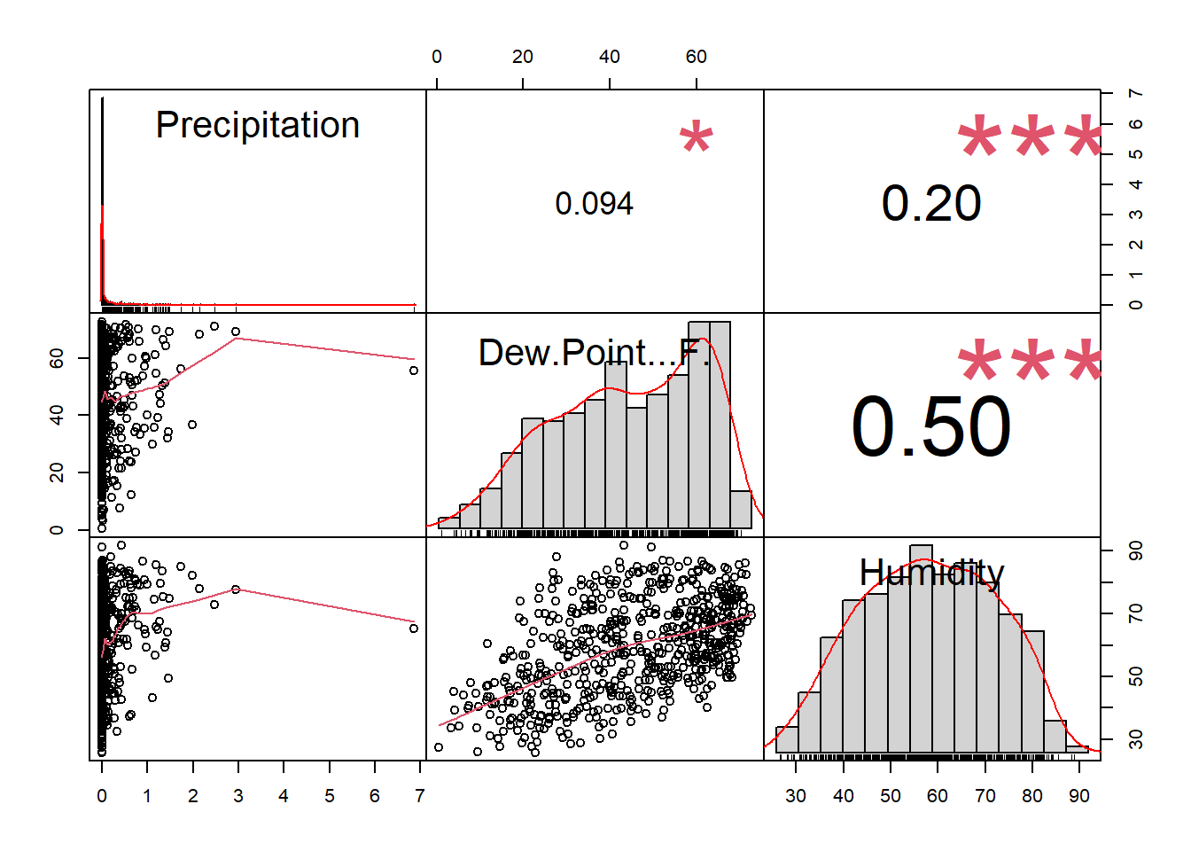
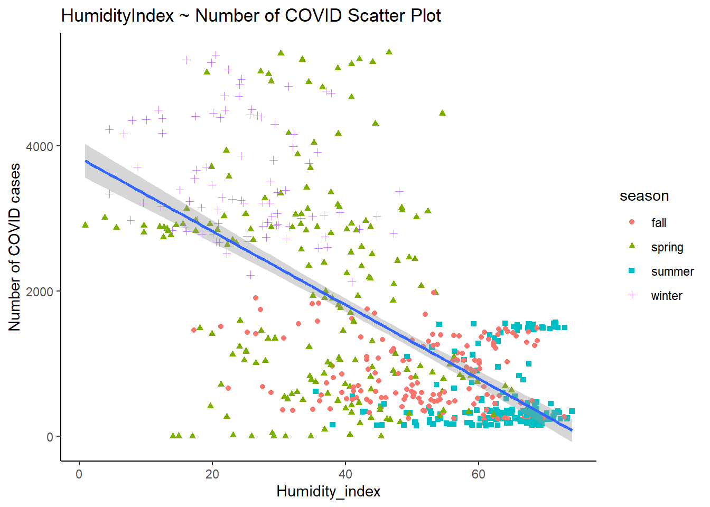
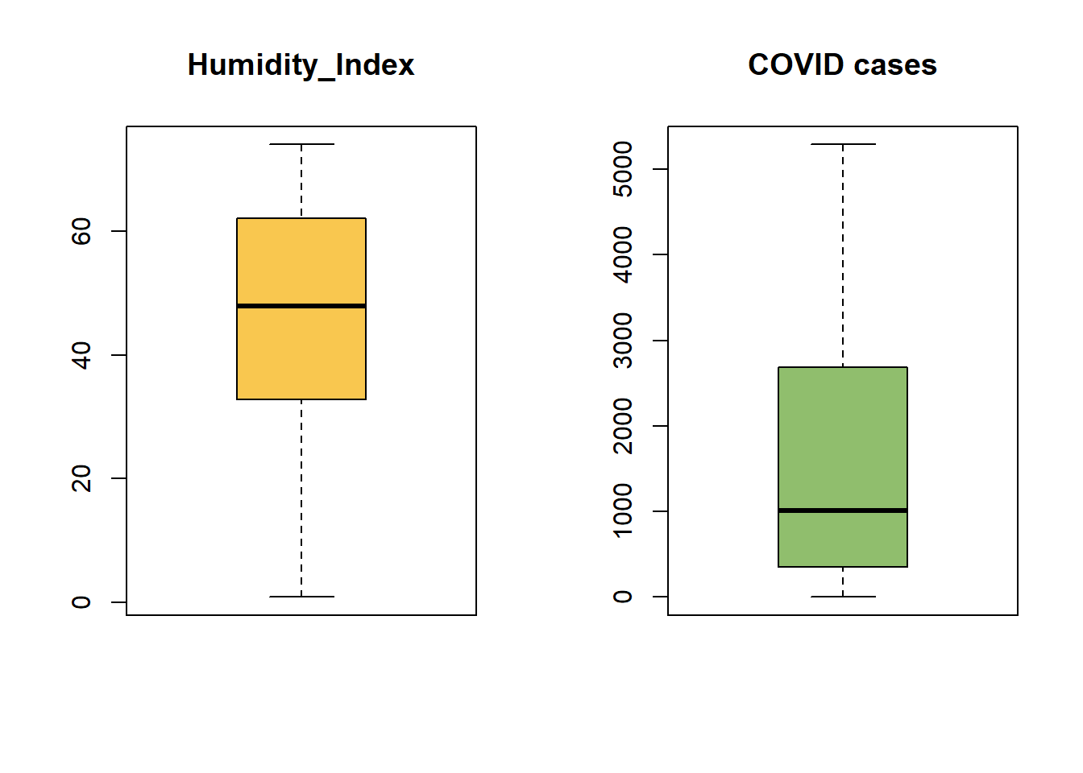
Data Exploration- Aim I(Humidity)
Humidity ~ COVID Cases visualization
Humidity Customized Index
Correlation
Humidity Index ~ COVID Cases

Slide 14
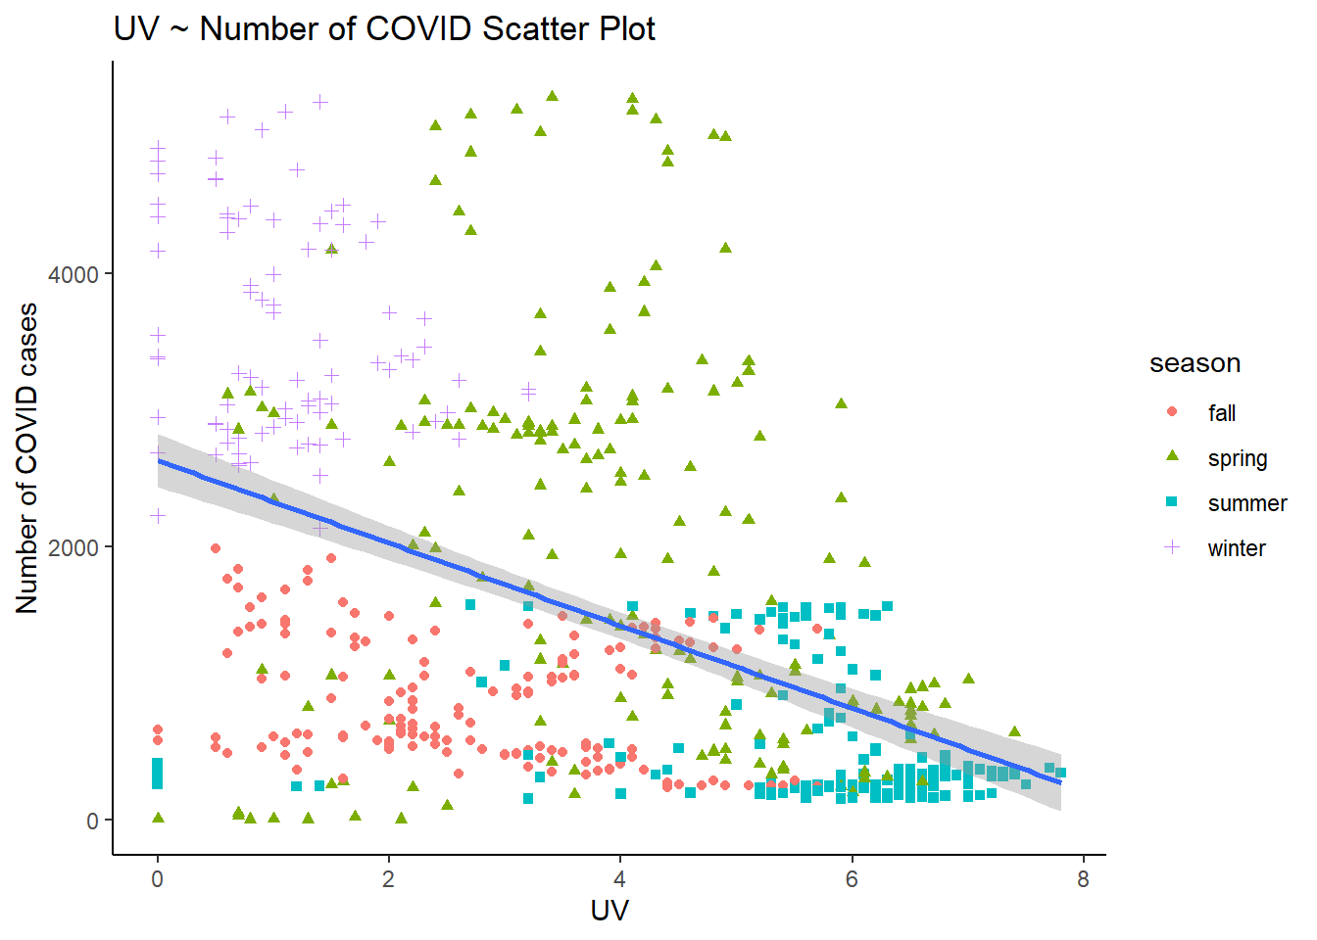
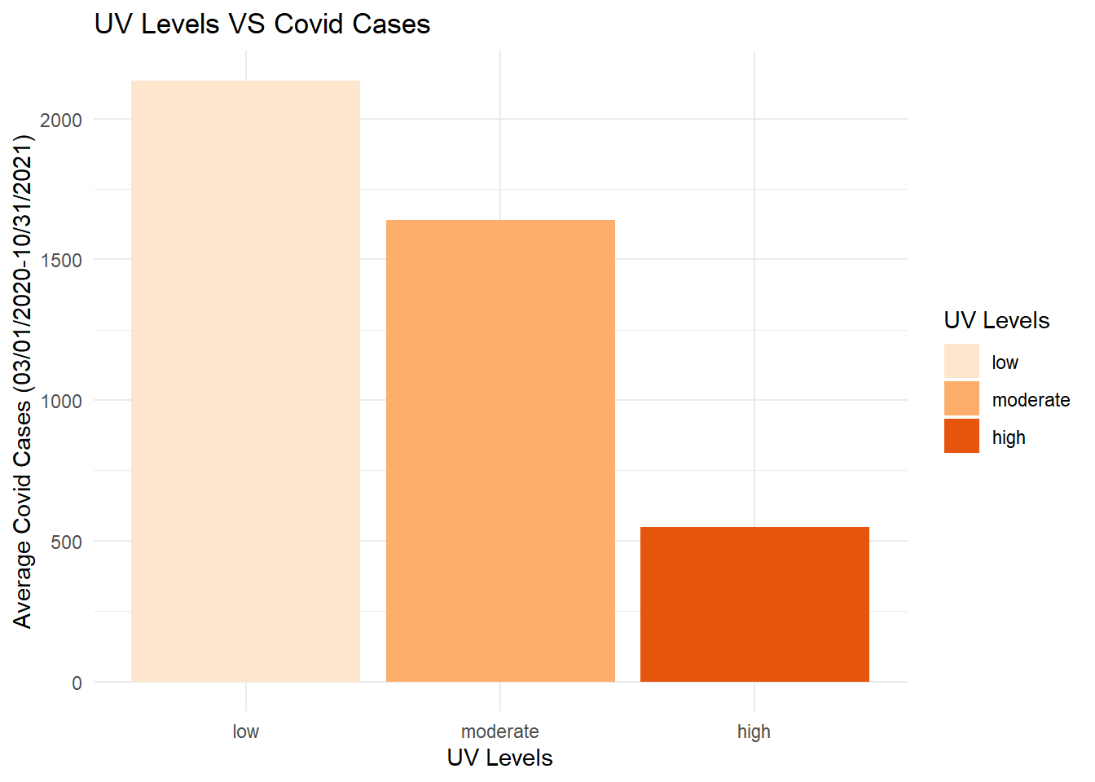
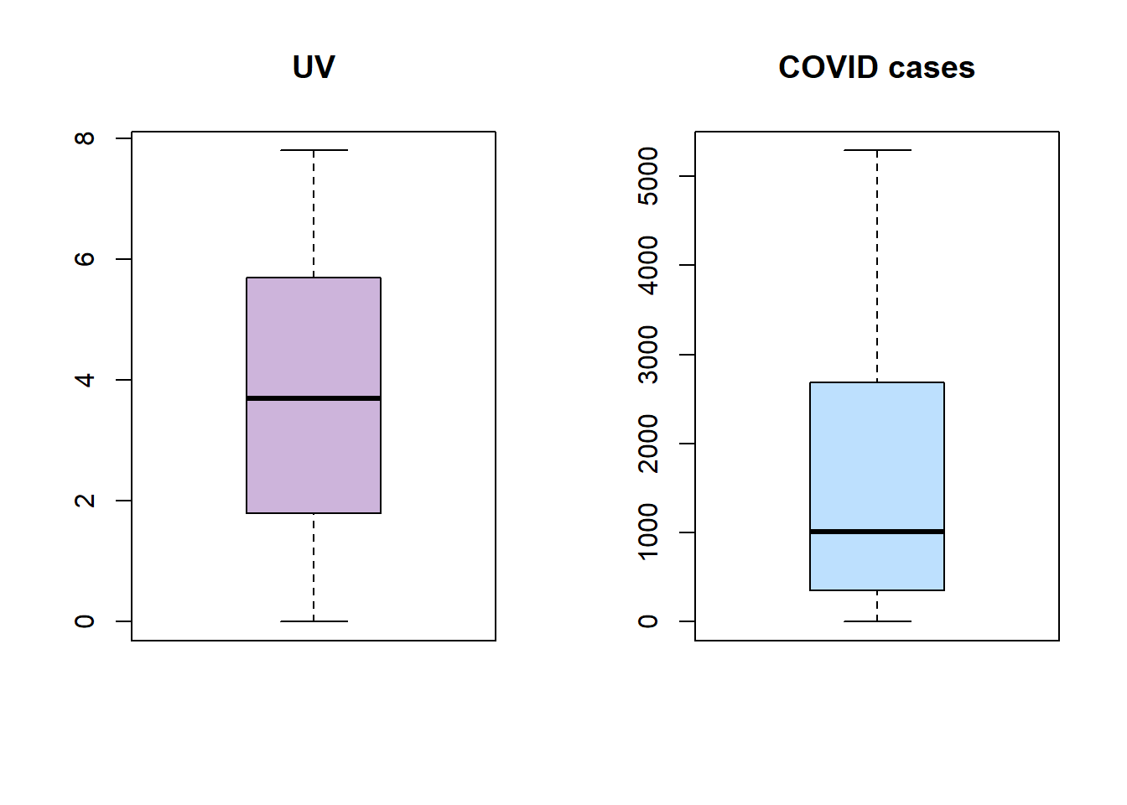
Data Exploration- Aim II(UV)
Ultraviolet ~ COVID Cases visualization
UV(Ultraviolet) ~ COVID Cases Bar Chart
UV(Ultraviolet) ~ COVID Cases

Slide 15
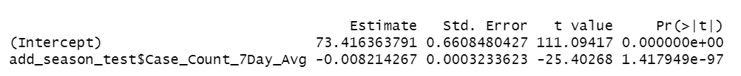
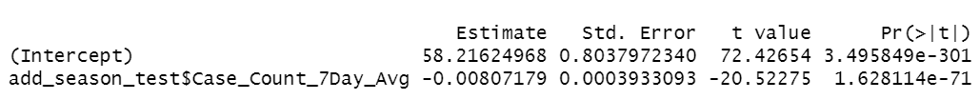
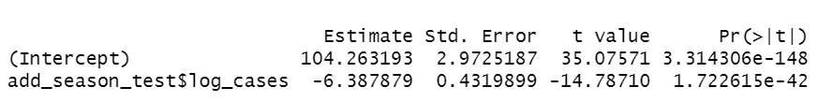
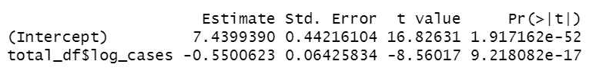
Simple Linear Regression
AIM I
Temperature ~ COVID Cases
Humidity ~ COVID Cases
Improved Temperature ~ log COVID Cases
Improved Humidity ~ log COVID Cases
AIM II
UV ~ COVID Cases
Improved UV ~ log COVID Cases

Slide 16
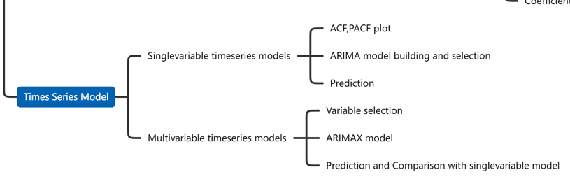
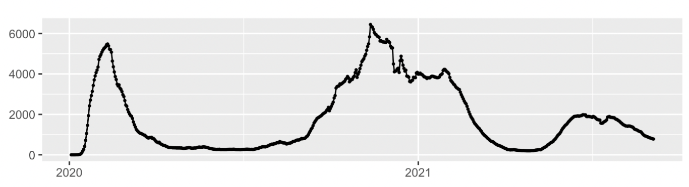
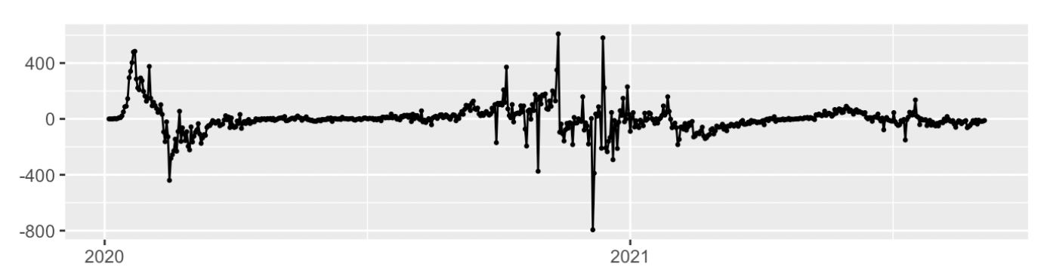
Times Series Prediction Model
Preparation for the models
The time series plot of the incidence of COVID-19
Differentiation of the time series

Slide 17
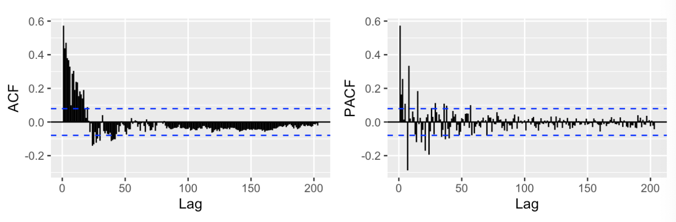
Times Series Prediction Model
Preparation for the models
ACF and PACF for the differentiated time series

Slide 18
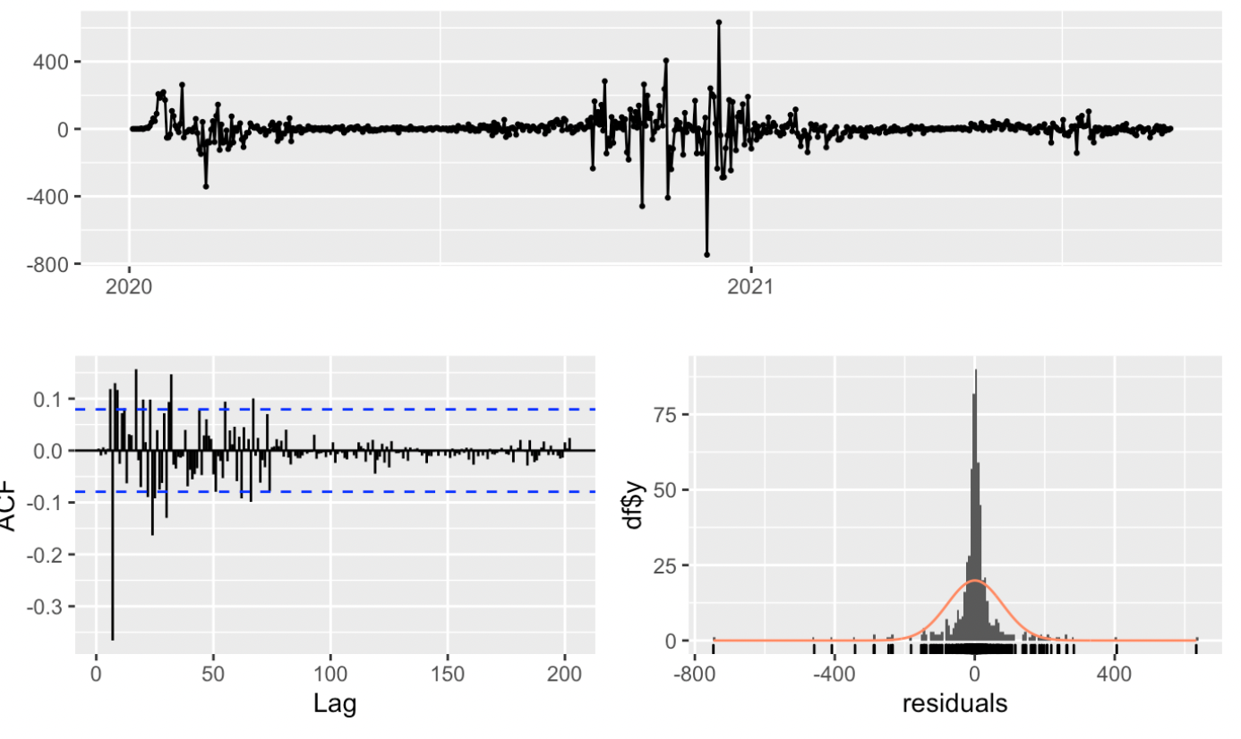
Times Series Prediction Model
Single-variable Model
Parameters of the Model 1
 | AR1 | MA1 | MA2 | MA3
PARAMETER | 0.8361 | -0.4127 | -0.1322 | 0.1599
S.E | 0.0491 | 0.0568 | 0.0496 | 0.0498
Residual Diagnose for model 1

Slide 19
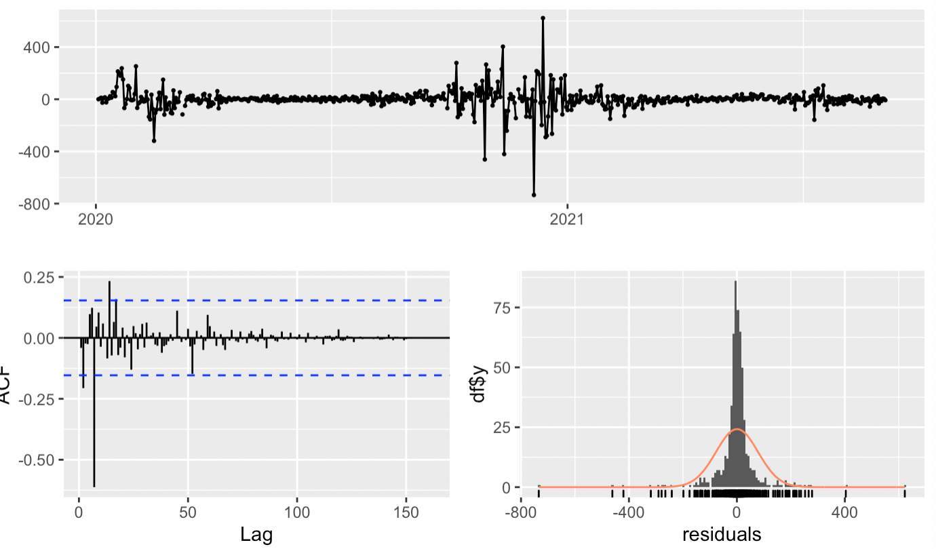
Times Series Prediction Model
Multi-variable model
Parameters of model with external variables
 | AR1 | AR2 | AR3 | Xreg
PARAMETER | 0.4595 | 0.0177 | 0.2605 | -0.6175
S.E | 0.0395 | 0.0438 | 0.0391 | 0.1781
Residual diagnosis of the
final multi-variable model
AIC:6950.91 VS 7058.9

Slide 20
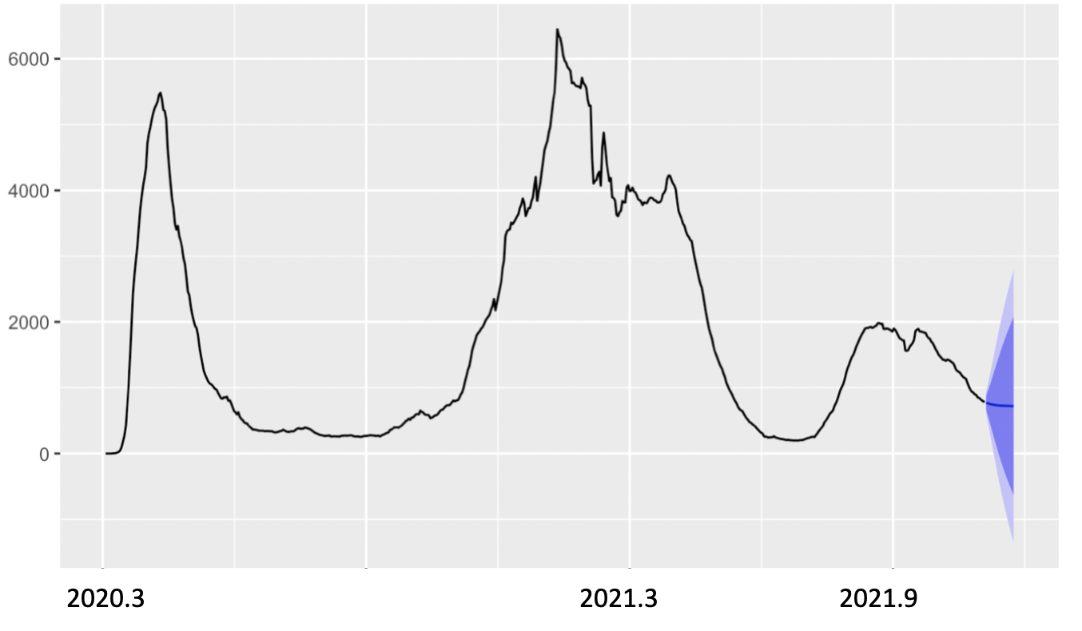
Times Series Prediction Model
Prediction

Slide 21
Conclusion
01
AIM I_(1)
Evidence-based “rational drug use” monitoring platform – 国家药品监控平台
AI-driven AE monitoring platform – 国家哨点联盟不良反应主动监测网
02
Funding & NCRC
国家基金
National disease-in-depth research hub and network: NCRC / 国家临床研究中心 (Eywa)
Pan-Asia Oncology RWE Alliance / 泛亚太肿瘤研究合作网络
03
Research
科研
Intelligent Hospital with Open Source AI Platform / 卫计委新版医院评级标准-智慧医院
Technology Driven research platform & High profile publisher & KOL network (人卫，AME）
04
Clinical
临床
DRG platform covering all diseases / departments in leading hospitals / 新一代DRG平台
CDSS (VTE, Infections, diabetes, COPD, oncology-relapse prediction model, etc) / 临床辅助决策系统开发
05
HTA & Payment
卫生技术评估
National HTA evaluation platform / 国家药品临床评价平台
HTA/HEOR national expert network and RWE-based policy shaping / 政策建议平台
06
Patient Centric
以患者为中心
Full life cycle patient management and RWE-generation platform / 全生命周期患者管理与RWE研究平台
RWE-Based Disease Education Network /循证医学教育网络： 人民医典与腾讯“我的健康”生态
07
Public Health
公共卫生
Intelligent City / 智慧城市 （宁波）
Public Safety Monitoring Platform / 城市公卫安全监测平台；武汉，北京，宁波，贵州

Slide 22
Conclusion
1.There is a significant relationship between the ultraviolet and the incident rate of Covid-19
2.Predict the next 20 days for the change of the incident rate of Covid-19

Slide 23
Limitation
The relationship we found between ultraviolet and Covid-19 is qualitative but not quantitative so we cannot get a general model for all range of ultraviolet
1
The model we created did not pass the pertemanteau Test for Residual, which means we did not generate a well-fitted one but there should be much better one to obtain
2
Our case count can be lower than actual due to insufficient report and case definition varied over time(symptom to neg/pos, anti-body test etc.)
3

Slide 24
Reference
World Health Organization. (n.d.). Who coronavirus (COVID-19) dashboard. World Health Organization. Retrieved October 7, 2021, from https://covid19.who.int/.
Shereen, M. A., Khan, S., Kazmi, A., Bashir, N., & Siddique, R. (2020, March 16). Covid-19 infection: Emergence, transmission, and characteristics of human coronaviruses. Journal of Advanced Research. Retrieved October 7, 2021, from https://www.sciencedirect.com/science/article/pii/S2090123220300540.
Sohrabi, C., Alsafi, Z., O'Neill, N., Khan, M., Kerwan, A., Al-Jabir, A., Iosifidis, C., & Agha, R. (2020, February 26). World Health Organization declares global emergency: A review of the 2019 novel coronavirus (COVID-19). International Journal of Surgery. Retrieved October 7, 2021, from https://www.sciencedirect.com/science/article/pii/S1743919120301977?casa_token=WTZxwhWNuLEAAAAA%3AA3C3_1UK_TKBVPQGVcSEiXa7opKEYR2GcCfCRKIKRo1no1fhQo8rlaKkxeY8LvK4H4WbaiDBdA
Methodological issues in evaluation models: The - ProQuest. (n.d.). Retrieved October 7, 2021, from https://www.proquest.com/docview/215248843?pq-origsite=gscholar&fromopenview=true.
Chin, A. W. H., Chu, J. T. S., Perera, M. R. A., Hui, K. P. Y., Yen, H.-L., Chan, M. C. W., Peiris, M., & Poon, L. L. M. (2020, January 1). Stability of SARS-COV-2 in different environmental conditions. Med Rxiv. Retrieved October 7, 2021, from https://www.medrxiv.org/content/10.1101/2020.03.15.20036673v2.
Ma, Y., Zhao, Y., Liu, J., He, X., Wang, B., Fu, S., Yan, J., Niu, J., Zhou, J., & Luo, B. (2020, March 26). Effects of temperature variation and humidity on the death of covid-19 in Wuhan, China. Science of The Total Environment. Retrieved October 7, 2021, from https://www.sciencedirect.com/science/article/pii/S0048969720317393?casa_token=TOC0gvxaQFoAAAAA%3AJPatyZEbY0V0esSH0ORsJh5jB_3y-5UXFaUDPFbXV5pxJnPqph7jS1nWC7gYvykUGk5Efqvcog.
Eslami, H., & Jalili, M. (2020, May 15). The role of environmental factors to transmission of SARS-COV-2 (COVID-19). AMB Express. Retrieved October 7, 2021, from https://www.ncbi.nlm.nih.gov/pmc/articles/PMC7226715/

Slide 25
Thanks
Q & A

